Slide 1
Function (1)

Slide 2
Objectives
This chapter introduces:
Introduction to a function
Writing a function
Scope of variables in a function

Slide 3
Function
Function is an independent program block that can perform specific code
The program can call the defined function to execute the specified program
The code of the function can be reused and is easy to maintenance

Slide 4
Function
A function is defined using the def keyword
The code in the function needs to be separated from other programs by indentation
To call a function, use the function name followed by parenthesis
The keyword to define a function
function_name()
def MyFunction():
'''
Function content
............
'‘’
#The indented blocks are function content of MyFunction()
#Use the function name() to call the function

Slide 5

Function
When the main program calls a function, the code in the function will be executed
After completing the execution of the code in the function, the function result will be sent back to the caller
The indented block includes function content
def SayHello():#the function needs to be defined before calling
print('Hello')
print('Good morning!')
print('Hi.')
SayHello()
print('Nice to meet you.')
Program output:

Slide 6

Function
Function can also declare variables, such as integer, floating-point number, or string
The keyword to define a function
function_name()
def show_num():
a = 1
while a <= 16:
print(a, end=' ')
a *= 2
print()
#The main program
show_num()# Call the function
show_num() # Call it again
The indented block includes function content
Program output:

Slide 7
Function
import time
#the main program
while 1:
period = time.strftime('%p')
if period == 'AM':
print(time.strftime('Am %I hour %M minute %S second'))
else:
print(time.strftime('PM %I hour %M minute %S second'))
time.sleep(1)
import time
#the function
def get_time():
period = time.strftime('%p')
if period == 'AM':
print(time.strftime('Am %I hour %M minute %S second')) else:
print(time.strftime('PM %I hour %M minute %S second'))
#the main program
while 1:
get_time()
time.sleep(1)
The left and the right program have the same functionality

Slide 8
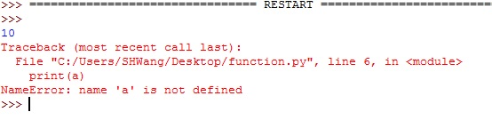
Local variable
Any variable present outside any function block is called a global variable
Its value is accessible from inside of any function
The variable declared in the function is a local variable
This variable can only be used in the function
After the function is completed, the local variable will be disappeared
def foo():
a = 10
print(a)
foo()
print(a)

Slide 9

Local variable
a = 1
b = 2
def foo():
#a += 2
#UnboundLocalError: the local variable 'a' referenced before assignment
a = 2 #the variables in Function will not replace the #variables in main program
print('1. a=' + str(a) + ' b=' + str(b))
a += b
print('2. a=' + str(a) + ' b=' + str(b))
foo()
print('3. a=' + str(a) + ' b=' + str(b))
Because the function does not declare any variable b, it accesses the global variable b
Output result ：
If we assign another value to a globally declared variable inside the function, a new local variable is created in the function's namespace. This assignment will not alter the value of the global variable.

Slide 10

Global variable
If you need to access and change the value of the global variable from within a function, this permission is granted by the global keyword
a = 1
b = 2
def foo():
global a #Specify a as the global variable
a = 2
print('1. a=' + str(a) + ' b=' + str(b))
a += b
print('2. a=' + str(a) + ' b=' + str(b))
foo()
print('3. a=' + str(a) + ' b=' + str(b))
Output result:

Slide 11
Source
References:
https://docs.python.org/3/library/functions.html
Python 深入淺出程式設計

Slide 12




Exercise 1
Design a program that will determine if the number inputted by the user is a prime or not. In addition, it will also ask the user to see if all factors of the inputted number is listed or not. The details can be seen in the example.
Output example:

Slide 13
Exercise 2
Write a program that accepts a sentence as input, and prints the numbers of letters and digits of the sentence on the screen.
Input: Output:
hello world! 123
The number of letters is: 10
The number of digits is: 3

Slide 14
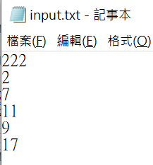
Exercise 3
Write a program that will read the data from input.txt and ask the user to input a number N. If the number N is not listed in the input.txt, it will print -1; otherwise, it will print how many numbers listed in the input.txt less than N.
Input: Output:
11
22
3
-1

